Slide 1
Scientific and Statistical Visualization
Cognitive Science and Visualization

Slide 2
visualization
pictures
The purpose of computing is insight, not numbers.
Richard Wesley Hamming
Card, Mackinlay, Shneiderman

Slide 3

vi·su·al·i·za·tion
1. Formation of mental visual images
2. The act or process of interpreting in visual terms or of putting into visible form

Slide 4
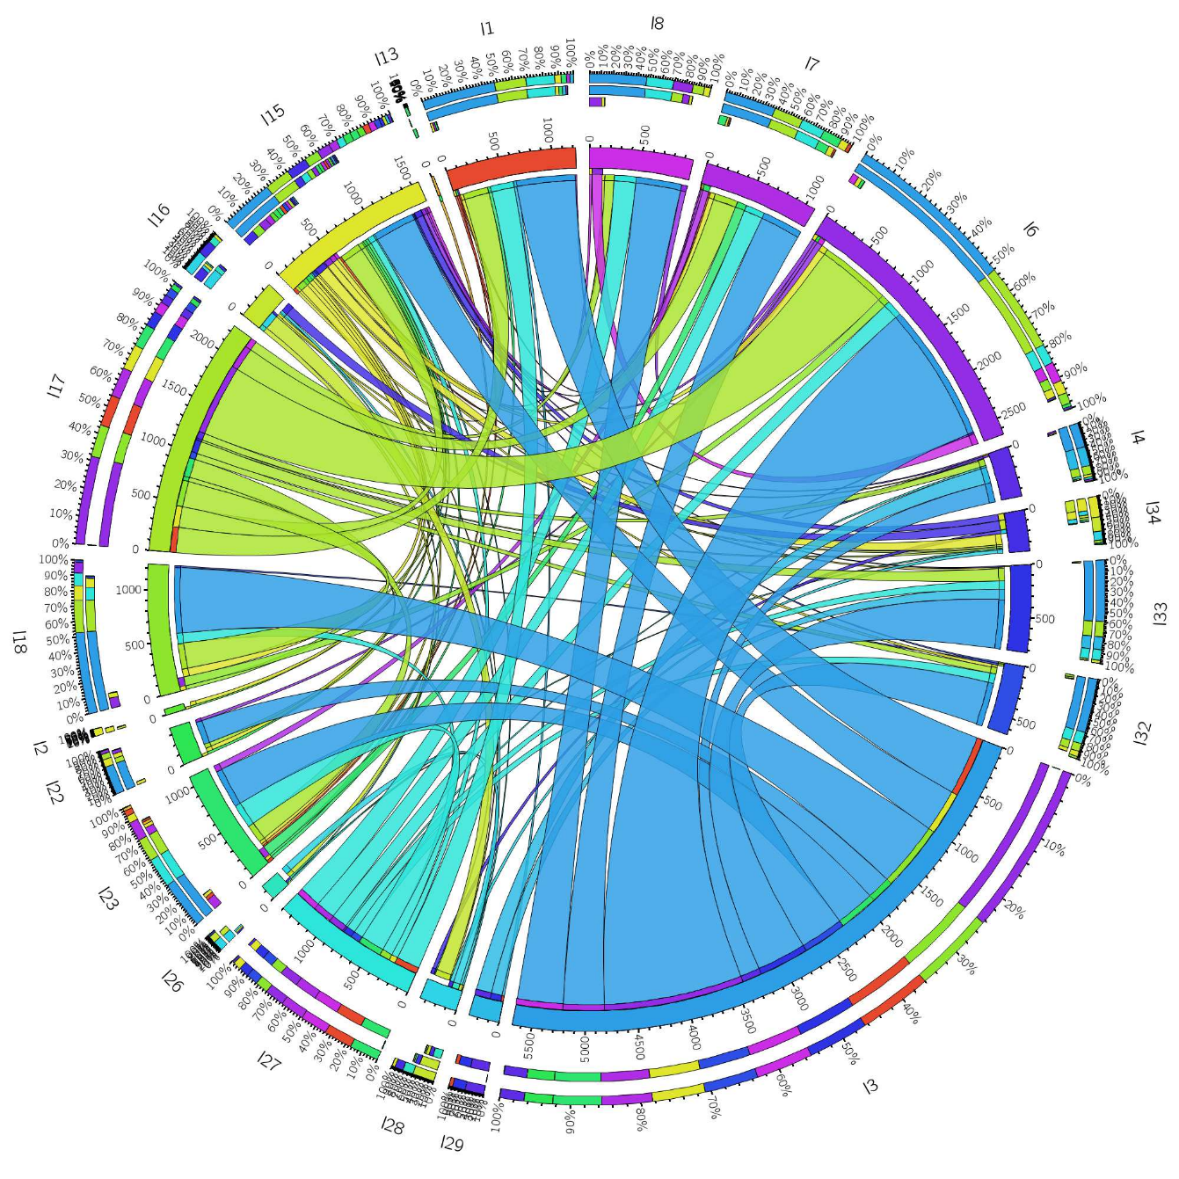
Visualization
Visualization is the process that transforms (abstract) data into interactive graphical representations for the purpose of exploration, conﬁrmation, or presentation.

Slide 5
Good Data Visualization…
Makes Data Accessible
Combines Strengths of humans and computers
Enables insight
Communicates

Slide 6
“Visualization is really about external cognition, that is, how resources outside the mind can be used to boost the cognitive capabilities of the mind.” - Stuart Card

Slide 7
Cognitive Science
Cognitive science is the interdisciplinary, scientific study of the mind and its processes. It examines the nature, the tasks, and the functions of cognition (in a broad sense).
Cognitive Science is a large field and we will only cover it briefly
Primarily to help us understand how people use and understand visualizations

Slide 8
High-level View of Cognitive Science
We are primarily interested in a few specific aspects of cognitive science:
Attention: how humans select important information from mass sense input
Knowledge and Processing of Language: How humans use shared symbols to communicate abstract ideas
Learning and Development: How people learn
Memory: How people remember in the short and long term
Perception: How we take information and process it

Slide 9
Cognitive Load
An important aspect of cognitive science in data visualization
cognitive load refers to the effort being used in the working memory. Cognitive load theory differentiates cognitive load into three types:
Intrinsic cognitive load is the effort associated with a specific topic,
Extraneous cognitive load refers to the way information or tasks are presented to a learner
Germane cognitive load refers to the work put into creating a permanent store of knowledge, or a schema.

Slide 10
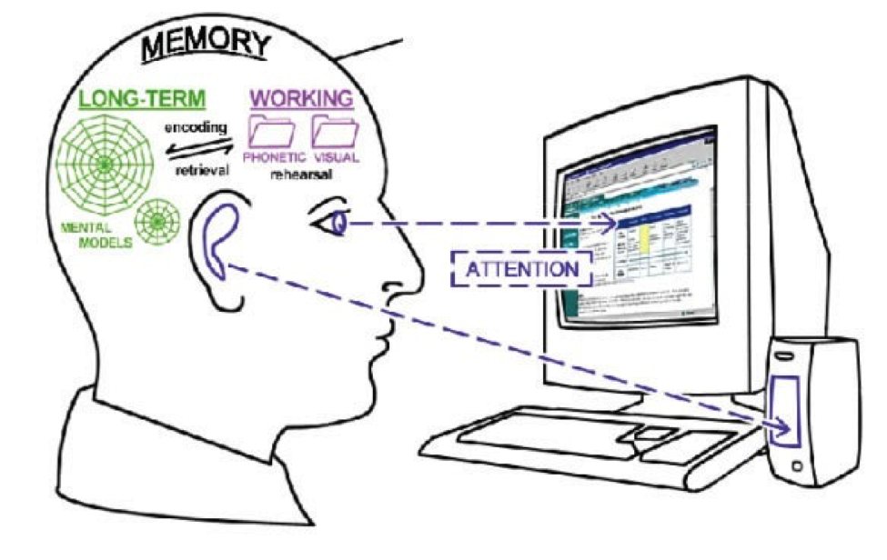
Cognitive Load Takeaway
The brain can only “hold on” to a certain number of “things” at once (4—7)
The brain uses “chunks” as a trick to store larger sets of “things” in the small number of slots
Too much information can result in poor performance, learning, and understanding of data visualization

Slide 11
ACT-R (1983)
External Environment
Encoding
Actions // Performance
Working Memory
Storage
Match
Retrieval
Execution
Declarative Memory
Production Memory

Slide 12




A Standard Model of the Mind
Slides originally created by Paul S. Rosenbloom
Based on Laird, J. E., Lebiere, C. & Rosenbloom, P. S. (2017). A Standard Model of the Mind: Toward a Common Computational Framework across Artificial Intelligence, Cognitive Science, Neuroscience, and Robotics. AI Magazine. In press.
Notes:
Not a machine learning talk per se, but here for timing issues
Some work that followed up on the last session of the 2013 AAAI Fall Symposium on Integrated Cognition

Slide 13
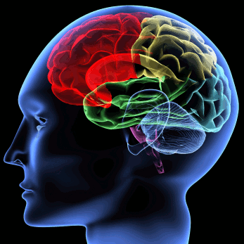

Minds
Functional entities that can think
And thus support intelligent behavior
Humans, and many animals possess minds
Implemented by brains
In AI, minds assumed to be computational entities
Cognitive systems
Implementable via a range of physical devices

Slide 14



Approaches to Understanding Minds
Artificial Intelligence (& AGI)
Concerns building artificial minds
Cares most for how such minds can be built
Cognitive Science
Concerns modeling natural minds
Cares most for understanding human cognitive processes
Neuroscience
Concerns structure and function of brains
Cares most for how minds arise from brains
Robotics
Concerns building and controlling artificial bodies
Cares most for how minds control such bodies

Slide 15
Towards a Common Understanding
Deep scientific question whether will converge on a single understanding of mind
Must at least happen for cognitive science and neuroscience
Naturally inspired AI/robotics may also fit if class slightly abstracted
So also may other work that is similar for functional reasons
Call this slightly abstracted class human-like minds
More the bounded rationality found in humans than AI optimality
Broader than naturally inspired minds
Narrower than human-level intelligence
Notes:
Includes natural and non-naturally-inspired but similar minds

Slide 16
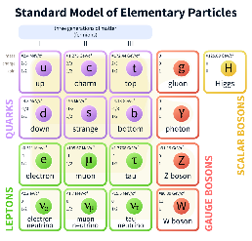
A Standard Model of Particle Physics
AN ANALOGY
Integrative model
Combines electromagnetic, weak and strong interactions
Classifies all of the known elementary particles
Community consensus developed over decades
Assumed to be internally consistent but may have gaps
Yields critical functionality for field
Cumulative reference point for progress
Guides efforts to extend and break it

Slide 17
A Standard Model of The Mind (SMM)
Focused on human-like minds
Grew out of a summary presentation at the 2013 AAAI Fall Symposium on Integrated Cognition
Yielded surprising consensus of those in attendance
Organizing committee for Symposium drawn from cognitive science, cognitively and biologically inspired AI, AGI, and robotics
Suggested a consensus has begun to emerge
Followed up with an article for AI Magazine
Extend consensus via a dialectic among ACT-R, Soar & Sigma
Laird, J. E., Lebiere, C. & Rosenbloom, P. S. (2017). A Standard Model of the Mind: Toward a Common Computational Framework across Artificial Intelligence, Cognitive Science, Neuroscience, and Robotics. AI Magazine. In press.

Slide 18
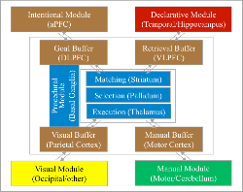
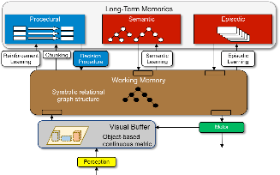
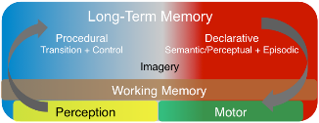
ACT-R, Soar & Sigma
ACT-R
Parallel, asynchronous modules
Central procedural memory
Only one result/module/cycle
Includes mapping to brain regions
Soar
Parallel, asynchronous modules
Central working memory
Bipartite declarative memory
Visuospatial module
Sigma
Blends CAs with graphical models
Less modular architecturally
Differing functionalities from
specialization and combination
Notes:
Original diagrams just colored to show common functionalities
ACT-R and Soar two longest and most well developed
ACT-R includes mapping to brain regions
Sigma is newer, partially based on learning from existing architectures

Slide 19
A Standard Model of The Mind (cont.)
What needs to be in a human-like cognitive architecture
Providing an abstract community consensus
But not itself a cognitive architecture
Yields a range of potential benefits
Coherent baseline to facilitate shared cumulative progress
Focus efforts to extend and break the consensus
Framework around which evaluation data can be organized
Interlingua for describing and comparing architectural approaches
Guidance in
Extending research on individual components
Interpreting experiments and suggesting new ones
Constructing intelligent applications
Notes:
Cognitive architecture: Working model of fixed structures that define a mind
For example, extending deep learning with memory, attention, etc.

Slide 20
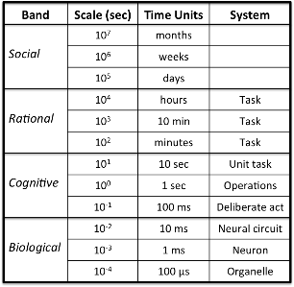
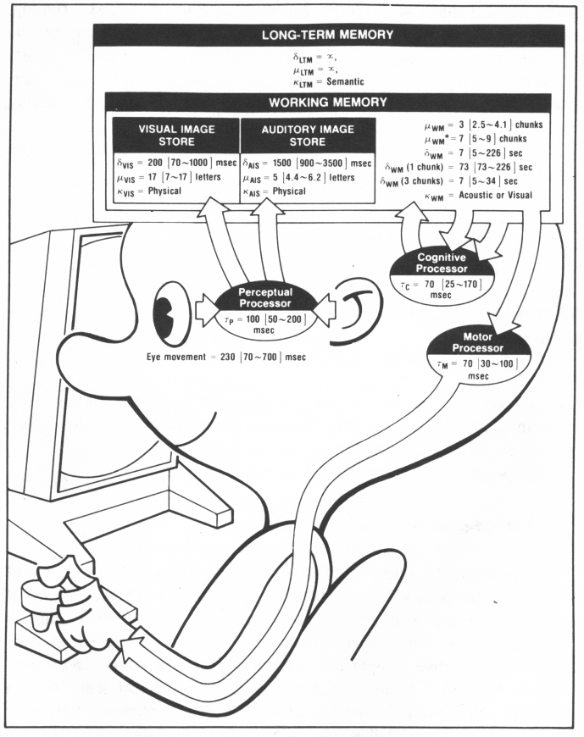
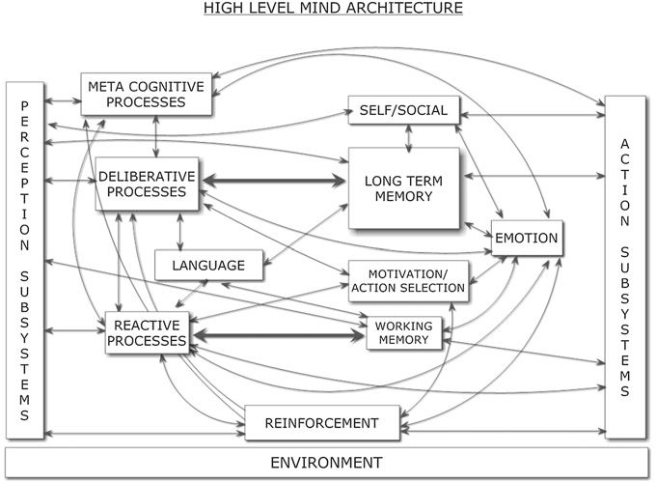
Some Precedents*
Amalgamated completeness
CogPrime, CogAff, LIDA, Psi, 4D-RCS, HTM/DeSTIN
rather than consensus
Scale Counts in Cognition
(Newell, 1990)
Model Human Processor
(Card, Moran & Newell, 1983)
Span mind
Deliberate Act up?
Very abstract
Parameters for HCI
Generic Architecture for Human-Like Cognition
(Goertzel, Pennachin & Geisweiller, 2014)*
Notes:
*Published after Symposium

Slide 21
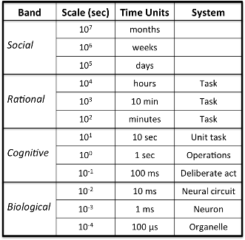
Deliberate Act Level (~100 ms)
Simple reaction time in humans (roughly)
Where cognitive architectures most commonly defined
Although may go a bit below
Where standard model is defined
Provides a physical symbol system
“… has the necessary and sufficient means for general intelligent action” (Newell & Simon, 1976)

Slide 22
Standard Model and Symbol Systems
Key aspect of symbols for SMM is composability
Symbols are those things that can be combined into relations
And support further combinations into networks of relations
Mirrors binding problem in cognitive neuroscience
Doesn’t assume symbols must be uninterpreted labels
Can be this and/or patterns over vectors of distributed elements
Doesn’t assume sufficiency at deliberate act level
Logically sufficient overall, but
Evidence shows non-symbolic needed at deliberate act level
To represent numeric and spatial information
To provide quantitative metadata over symbol structures
Frequency, recency, co-occurrence, similarity, utility, activation
Notes:
Not necessarily at this point concerned with other aspects of symbols
Designation, grounding, …
Major breaks with traditional notions of cognitive architectures and symbols

Slide 23
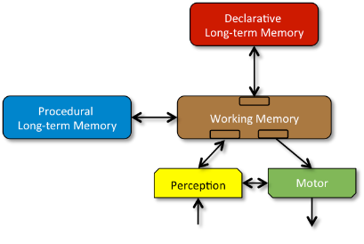
Standard Model
Our understanding of consensus from AAAI symposium fleshed out based on dialectic among three architectures
Finding out what each actually meant and most believed
A set of communicating modules
Each may be decomposed further
But not just undifferentiated stuff
Global comms. through WM
Local Perception↔︎Motor comms.
Procedural can access all of WM
Others access only own WM buffers
At this level of detail, not too novel
Although bipartite LTM is relatively new as a consensus

Slide 24
Standard Model (cont.)
Structure and Processing
Memory and Content
Learning
Perception and Motor

Slide 25
A. Structure and Processing
Processing yields bounded rationality, not optimality
Processing based on a few task-independent modules
There is significant parallelism in architectural processing
Processing is parallel across modules
Processing is parallel within modules
A cognitive cycle that runs at ~50 ms per cycle in humans drives behavior via sequential action selection
Complex behavior arises from a sequence of independent cognitive cycles that operate in their local context
Notes:
Not distinct modules for more complex behavior

Slide 26
B. Memory and Content
Declarative and procedural LTMs contain symbol* structures and associated quantitative metadata
Global communication is provided by a short-term WM
Global control is provided by procedural LTM
Composed of rule-like conditions and actions
Exerts control by altering contents of WM
Factual knowledge is provided by declarative LTM
Notes:
*Symbols as earlier discussed

Slide 27
C. Learning
All forms of LTM content are learnable
Learning occurs online and incrementally, as a side effect of performance and is often based on an inversion of the flow of information from performance
Procedural learning involves at least reinforcement learning and procedural composition
Reinforcement learning yields weights over action selection
Procedural composition yields behavioral automatization
Declarative learning involves the acquisition of facts and tuning of their metadata
More complex forms of learning involve combinations of the fixed set of simpler forms of learning

Slide 28
D. Perception and Motor
Perception yields symbol* structures with associated metadata in specific WM buffers
There can be many different such perception modules
Perceptual learning acquires new patterns & tunes existing ones
Attentional bottleneck constrains information available in WM
Perception can be influenced by top-down information from WM
Motor control converts symbol* structures in its buffers into external actions
There can be multiple such motor modules
Motor learning acquires new action patterns & tunes existing ones
Notes:
*Symbols as earlier discussed
Least well defined aspect of SMM

Slide 29
Analysis of Three Architectures
Structure and Processing
Memory and Content
Learning
Perception and Motor
ACT-R & Soar disagreed in a number of ways decades ago
Although disagreed about different things
Now in essentially complete agreement on this consensus
Although not all is completely implemented
Sigma differs further in placing some functionality above architecture
And less completely implemented at this point
Notes:
ACT-R: Structure and processing, learning, P&M
Soar: Memory and content, learning
Convergence is striking for ACT-R and Soar

Slide 30
Conclusion
Standard model reflects a very real initial consensus
Serial and parallel processing
Symbolic and subsymbolic representations
Procedural and declarative memories
Pervasive learning
But it remains incomplete in a number of ways
Metacognition, emotion, mental imagery, distinction between declarative memories, social cognition, etc.
And may still be wrong in various ways
Hope is that it yields sound beginning to build upon via more
Consensus across architectures, researchers, data and disciplines
Work on challenges, corrections and extensions
2017 AAAI Fall Symposium on SMM
To “begin the process of broader community involvement”
Notes:
Hope many of you will consider participating!

Slide 31
What is ACT-R?
ACT-R is a cognitive architecture, a theory about how human cognition works.
Looks like a (procedural) programming language.
Constructs based on assumptions about human cognitions.

Slide 32
What is ACT-R?
ACT-R is a framework
Researchers can create models that are written in ACT-R including
ACT-R’s assumptions about cognition.
The researcher’s assumptions about the task.
The assumptions are tested against data.
Reaction time
Accuracy
Neurological data (fMRI)

Slide 33
What is ACT-R?
ACT-R is an integrated cognitive architecture.
Brings together not just different aspects of cognition, but of
Cognition
Perception
Action
Runs in real time.
Learns.
Robust behavior in the face of error, the unexpected, and the unknown.

Slide 34
Overview of ACT-R
ACT-R is made up of
Modules.
Buffers.
A subsymbolic level.

Slide 35
Overview of ACT-R
Intentional Module (not identified)
Declarative Module (Temporal/Hippocampus)
Goal Buffer (DLPFC)
Retrieval Buffer (VLPFC)
Matching (Striatum)
Productions
(Basal Ganglia)
Selection (Pallidum)
Execution (Thalamus)
Visual Buffer (Parietal)
Manual Buffer (Motor)
Visual Module (Occipital/etc)
Manual Module (Motor/Cerebellum)
Environment

Slide 36
Perceptual-Motor Modules
Takes care of the interface with the “real” world.
Visual module
Auditory module
Motor module
etc

Slide 37
Perceptual-Motor Modules
3 tones: low, med, high
445ms
3 positions: left, middle, right
279ms
Tones and positions
456ms
283ms

Slide 38
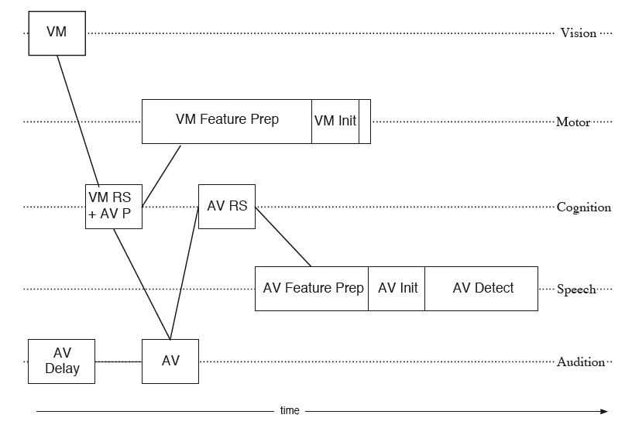
Perceptual-Motor Modules

Slide 39
Declarative Module
Declarative memory:
Facts
Washington, D.C. is the capital of the U.S.
2+3=5.
Knowledge a person might be expected to have to solve a problem.
Called chunks

Slide 40
Declarative Module
(
)
CHUNK-TYPE
NAME
SLOT1
SLOT2
SLOTN
(
b
isa
count-order
first
1
second
2
)

Slide 41
Procedural Module
Procedural memory: Knowledge about how to do something.
How to type the letter “Q”.
How to drive.
How to perform addition.

Slide 42
Procedural Module
Made of condition-action data structures called production rules.
Each production rule takes 50ms to fire.
Serial bottleneck in this parallel system.

Slide 43
Procedural Module
(
p
name
Specification of
Buffer Tests
condition part
delimiter
==>
Specification of
Buffer Transformations
action part
)

Slide 44
Procedural Module
(
p
example-counting
=goal>
isa count
state counting
number =num1
=retrieval>
isa count-order
first =num1
second =num2
=goal>
number =num2
+retrieval>
isa count-order
first =num2
IF the goal is
to count
the current state is counting
there is a number called =num1
and a chunk has been retrieved
of type count-order
where the first number is =num1
and it is followed by =num2
THEN
change the goal
to continue counting from =num2
and request a retrieval
of a count-order fact
for the number that follows =num2
==>
)

Slide 45
Buffers
The procedural module accesses the other modules through buffers.
For each module (visual, declarative, etc), a dedicated buffer serves as the interface with that module.
The contents of the buffers at any given time represent the state of ACT-R at that time.

Slide 46
Buffers
1. Goal Buffer (=goal, +goal)
-represents where one is in the task
-preserves information across production cycles
2. Retrieval Buffer (=retrieval, +retrieval)
-holds information retrieval from declarative memory
-seat of activation computations
3. Visual Buffers
-location (=visual-location, +visual-location)
-visual objects (=visual, +visual)
-attention switch corresponds to buffer transformation
4. Auditory Buffers (=aural, +aural)
-analogous to visual
5. Manual Buffers (=manual, +manual)
-elaborate theory of manual movement include feature preparation, Fitts law, and device properties

Slide 47
Overview of ACT-R
Intentional Module (not identified)
Declarative Module (Temporal/Hippocampus)
Goal Buffer (DLPFC)
Retrieval Buffer (VLPFC)
Matching (Striatum)
Productions
(Basal Ganglia)
Selection (Pallidum)
Execution (Thalamus)
Visual Buffer (Parietal)
Manual Buffer (Motor)
Visual Module (Occipital/etc)
Manual Module (Motor/Cerebellum)
Environment

Slide 48
Counting Example
http://act-r.psy.cmu.edu/tutorials/
Unit 1

Slide 49
Subsymbolic Level
The production system is symbolic.
The subsymbolic structure is a set of parallel processes that can be summarized by a number of mathematical equations.
The subsymbolic equations control many of the symbolic processes.

Slide 50
Subsymbolic Level
For example, if several productions match the state of the buffers, a subsymbolic utility equation estimates the relative cost and benefit associated with each production and selects the production with the highest utility.

Slide 51
Production Utility
P is expected probability of success
G is value of goal
C is expected cost
t reflects noise in evaluation
and is like temperature in
the Bolztman equation
α is prior successes
m is experienced successes
β is prior failures
n is experienced failures

Slide 52
Subsymbolic Level
For another example, whether and how fast a chunk can be retrieved from declarative memory depends on the subsymbolic retrieval equations, which take into account the context and the history of usage of that fact.

Slide 53
Chunk Activation
The activation of a chunk is a sum of base-level activation, reflecting its general usefulness in the past, and an associative activation, reflecting it’s relevance in the current context.

Slide 54
Chunk Activation
Attentional weighting of
Element j of Chunk i
Activation of Chunk i
A_{i} = B_{i} + Σ W_{j}S_{ji}
j
Strength of association
of Element j to Chunk i
Base-level activation
(Higher if used recently)

Slide 55
Chunk Activation
B_{i}
addend1
Addition-Fact
addend 2
Eight
Four
S_{ji}
S_{ji}
W_{j}
W_{j}
S_{ji}
Sum
Twelve

Slide 56
Chunk Activation
B_{i}
addend1
Addition-Fact
addend 2
Eight
Four
W_{j}
S_{ji}
S_{ji}
W_{j}
S_{ji}
Sum
Twelve
W_{j} decreases with the number of elements associated with
Chunk i.
S_{ji} decreases with the number of chunks associated with the
element.

Slide 57
Probability of Retrieval
The probability of retrieving a chunk is given by
P_{i} = 1 / (1 + exp(-(A_{i} - τ)/s))

Slide 58
Retrieval Time
The time to retrieve a chunk is given by
T_{i} = F exp(-A_{i})

Slide 59
Subsymbolic Level
The equations that make up the subsymbolic level are not static and change with experience.
The subsymbolic learning allows the system to adapt to the statistical structure of the environment.

Slide 60
ACT-R: The Oldest Core Principles
1. The Procedural-Declarative Distinction
a. The declarative component originated in Anderson & Bower (1973) HAM network representation of memory.
b. The procedural component originated in Newell’s (1973) production system theory of cognitive control.
c. Both the procedural and declarative components have evolved far from these origins.
The Symbolic-Subsymbolic Distinction
In addition to the symbolic level that represented knowledge there is a subsymbolic level that controls access to that knowledge.
The subsymbolic level was initially designed to reflect the 1970s & 1980s ideas about neural processing.
Guided by rational analysis the subsymbolic level was updated in 1993 to reflected the likelihood that the information was useful. This was the birth of ACT-R.

Slide 61
Modules in ACT-R 6.0
Modules are high capacity, parallel, and asynchronous
Goal
Imaginal
Declarative
Buffers provide narrow paths of communication -- only hold a chunk in ACT-R terms.
Procedural
Visual
Aural
Production system that contains rules that recognize patterns and react
Manual
Vocal

Slide 62
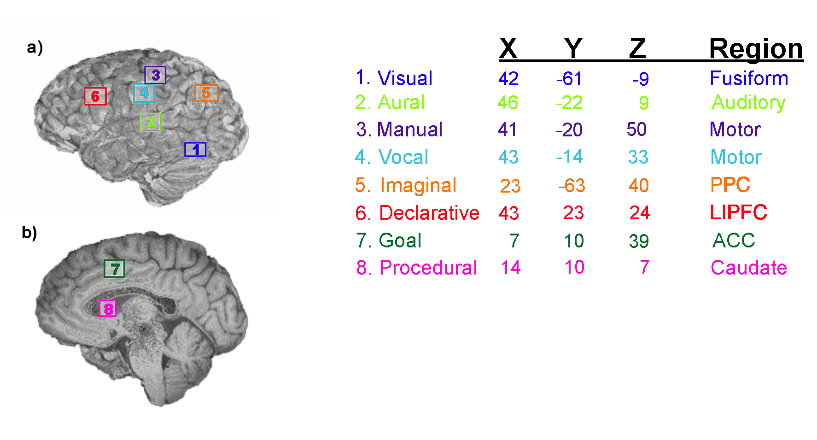
ACT-R Module-Region Mappings

Slide 63
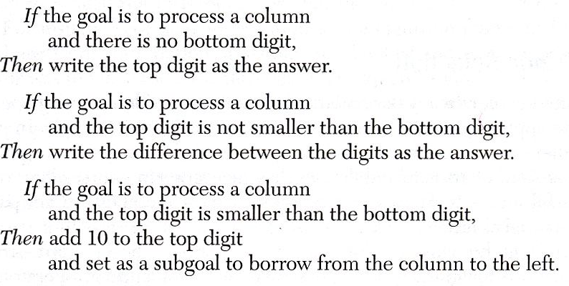
The Procedural Component in ACT-R has Evolved from Computer Science Notation to Description of the Brain’s Action Selection
600517
23523
4

Slide 64
The First Real ACT-R Production Rule
If the goal is to process a column
and the top digit is not smaller than the bottom digit,
Then write the difference between the digits as the answer
Responds to a Particular Pattern that Appears in the Buffers of a Set of Modules
Selects an
Action
Which consists of requests to other Modules
Goal>
Task: Subtracting
Goal>
Task: Process-Column
Imaginal>
Top: 7
Relation: >=
Bottom: 3
Declarative>
Type: subtraction
Minuend: 7
Subtrahend: 3
Request
Difference
Notes:
23

Slide 65
The Second Real ACT-R Production Rule
If the goal is to process a column
and the top digit is not smaller than the bottom digit,
Then write the difference between the digits as the answer
Responds to a Particular Pattern that Appears in the the Buffers of a Set of Modules
Selects an
Action
Which consists of requests to other Modules
Goal>
Task: Subtracting
Goal>
Task: Next-column
Declarative>
Type: subtraction
Difference: 4
Manual>
Action: write
Digit: 4
Harvest
Difference

Slide 66
Attributes of Production Rules
Production rules are stimulus-response bonds that have “gone over to the cognitive side” because among the stimuli they respond to are past memories, mental images, and control states.
Respond to conjunctions of elements in the various buffers.
These buffers can represent relational structures -- e.g. A above B.
Note how innocuous the use of variables is -- it basically copying information from one brain region to another.
Stewart, T.C. and Eliasmith, C. (2008). Building production systems with realistic spiking neurons. 30th Annual Meeting of the Cognitive Science Society.
Stocco, A., Lebiere, C., & Anderson, J. R. (in revision). Conditional routing of information to the cortex: A model of the role of basal ganglia in high-level cognition. Psychological Review

Slide 67
Learning of New Production Rules
New Problem Situations
Requires Deliberation
Declarative Representations
Interpreted
Analogy to Prior Experiences (e.g. Past Tense Model)
Deduction
From 1st
Principles
Following instructions (e.g. Multicolumn Subtraction)
Traces Feed Into
Production Compilation
Eventually
Produces
New Production Rules

Slide 68
What has Happened to the Declarative Component in ACT-R?
It has bifurcated into two completely separate things:
An increasingly watered-down set of principles for the representation of knowledge, which comes to be the contents of module buffers. This is clearly a place where important new thinking is required.
An increasingly empirically well-founded set of principles (with a foundation in rational analysis) for how the brain performs controlled retrieval of information from declarative memory.

Slide 69
Buffers and Declarative Memory
Buffers associated with modules provide narrow paths of communication.
The contents of the buffers are called chunks.
Records of these chunks are placed in declarative memory.
These can be later retrieved and placed in the declarative buffer.
Goal
Imaginal
Declarative
Procedural
Visual
Aural
Manual
Vocal
Notes:
28

